Slide 1

CONCRETE SURFACE CRACK CLASSIFICATION USING SWIN-TINY TRANSFORMER
23EC2001-Introduction to Data Analytics
Guide: Dr P. Malin Bruntha, M.E., Ph.D
Sidhee Vinod (URK23EC3003) and Indhurani K (URK23EC6026)
B.Tech Electronics and Computer Engineering

Slide 2


PROBLEM STATEMENT
01
Structural risk
02
Limits of manual inspection
Cracks in buildings, bridges, roads and dams can signal deterioration.
Visual inspection is time-consuming, labour-intensive and subjective, so results vary between inspectors.
03
The task
04
The research question
Classify each concrete surface image as crack or no-crack, treating crack as the positive class.
Which architecture and training strategy (pretrained transfer learning vs. training from scratch) classifies cracks best, judged by more than accuracy alone?
Notes:
3

Slide 3
OBJECTIVES OF THE PROJECT
01
Compare five architectures
ConvNeXt V2-Tiny, EfficientNetV2-S, RepViT, ResNet50 and Swin-Tiny on binary crack classification.
02
Compare training strategies
Pretrained fine-tuning (four models) against training from scratch (Swin-Tiny).
03
Evaluate comprehensively
Accuracy, precision, recall, specificity, F1-score and ROC-AUC, plus confusion matrices and McNemar tests.
04
Explain the predictions
Use Grad-CAM to see which image regions drive each model's decision, including error cases.
Notes:
4

Slide 4
INTRODUCTION
Concrete cracks form from loading, shrinkage, temperature variation, environmental exposure and material deterioration. Early detection supports maintenance planning, but manual visual inspection is slow, labour-intensive and depends on the inspector's experience.
This project compares five deep learning architectures, CNNs and a Swin Transformer, for classifying concrete surface images as crack or no-crack. It evaluates them with six metrics, statistical tests and Grad-CAM explanations.

Slide 5
LITERATURE SURVEY
Classical ML and benchmarks
CNNs and transfer learning
Kim et al. [1] classified crack and non-crack images with machine learning. Dorafshan et al. [2] released SDNET2018, a widely used concrete crack dataset.
Su and Wang [4] and Le et al. [5] showed pretrained CNNs detect concrete cracks well. Islam and Kim [3] used an encoder-decoder network.
Transformers and hybrids
Lightweight and explainable
Ye et al. [11] proposed a transformer-based crack classifier; Yadav et al. [12] bridged CNNs and transformers for efficient detection.
Wang et al. [14] improved MobileNetV3 for lightweight use; Swarna et al. [15] added explainable AI to crack detection.
Research gap: few studies compare modern CNNs and a transformer on one dataset with statistical tests and Grad-CAM together.

Slide 6
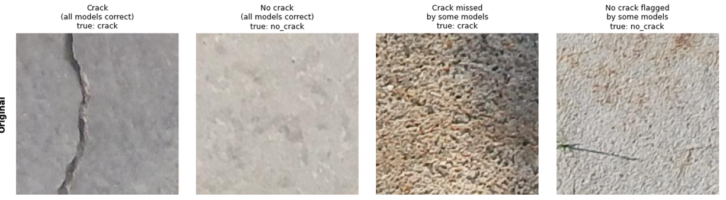
DATASET DESCRIPTION
Training
Validation
Testing
28,000 images (70%)
8,000 images (20%)
4,000 images (10%)
Balanced classes: equal crack and no-crack counts in every subset. Total: 40,000 concrete surface images. The splitting procedure should be checked for related patches across subsets (possible data leakage).
Why balanced?
Both crack recall and no-crack specificity can be judged fairly.
Sample test images: crack, no-crack, a hard crack on rough texture, and a hard no-crack with a dark mark.
Notes:
8

Slide 7
PROPOSED METHODOLOGY
1 Dataset
2 Split
3 Preprocess
4 Models
5 Train
6 Evaluate
40,000 images, crack / no-crack, balanced
70 / 20 / 10 percent: train, validation, test
Resize, tensor conversion, normalize; augment train only
Five architectures, two-logit output head
Monitor validation each epoch; keep best checkpoint
Test set, softmax; metrics, confusion, Grad-CAM
>
>
>
>
>
Transfer learning (pretrained, fine-tuned)
Training from scratch
ConvNeXt V2-Tiny, EfficientNetV2-S, RepViT and ResNet50 start from pretrained weights.
Swin-Tiny starts from random initialization, so its comparison reflects the full configuration, not architecture alone.

Slide 8
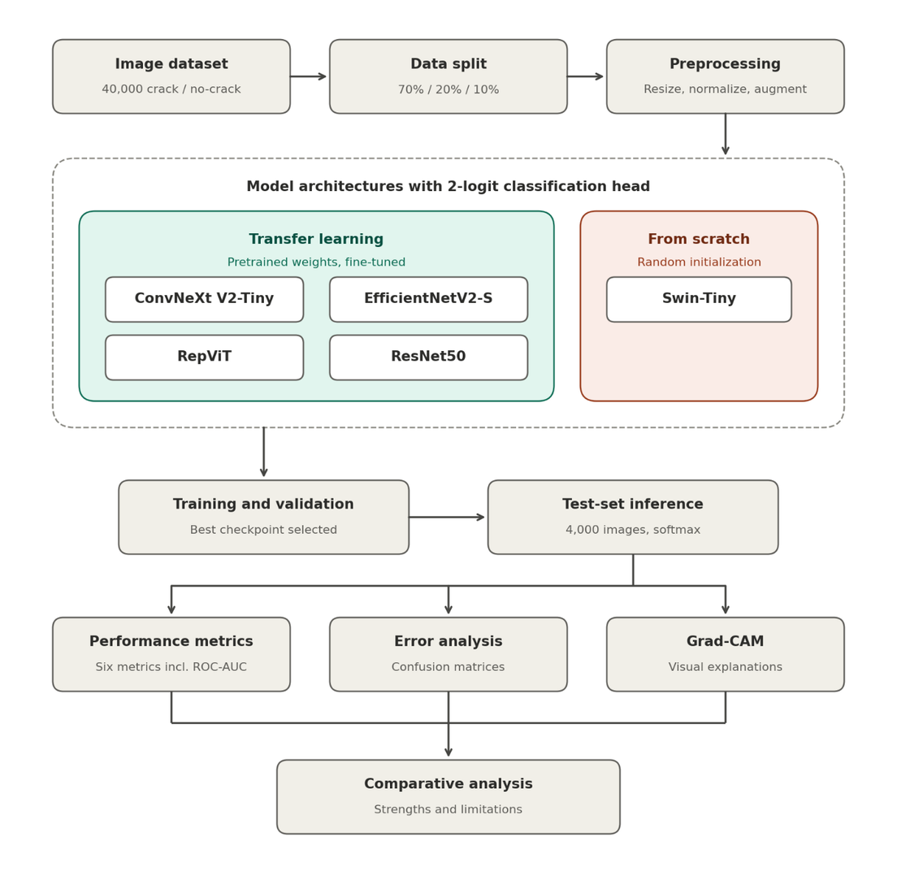
PROPOSED METHODOLOGY

Slide 9
MODEL ARCHITECTURES
Model | Family | Initialization
ConvNeXt V2-Tiny | Modern CNN | Pretrained, fine-tuned
EfficientNetV2-S | CNN | Pretrained, fine-tuned
RepViT | Lightweight CNN / ViT hybrid | Pretrained, fine-tuned
ResNet50 | CNN (baseline) | Pretrained, fine-tuned
Swin-Tiny | Vision Transformer | From scratch
All five use a two-logit classification head; softmax converts logits to class probabilities.
Notes:
9

Slide 10
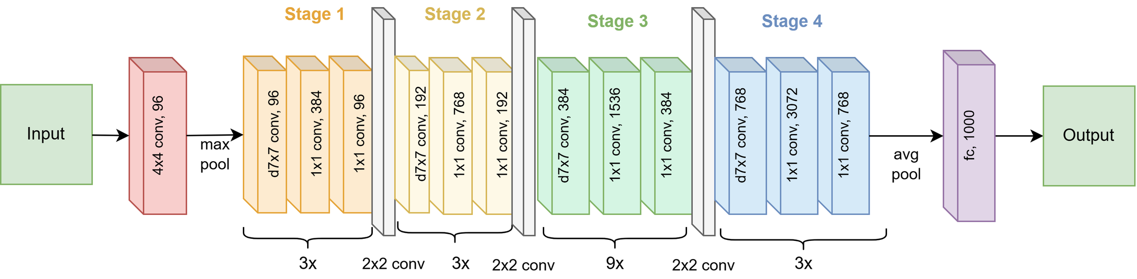
ConvNeXt V2-Tiny Architecture
Notes:
9

Slide 11
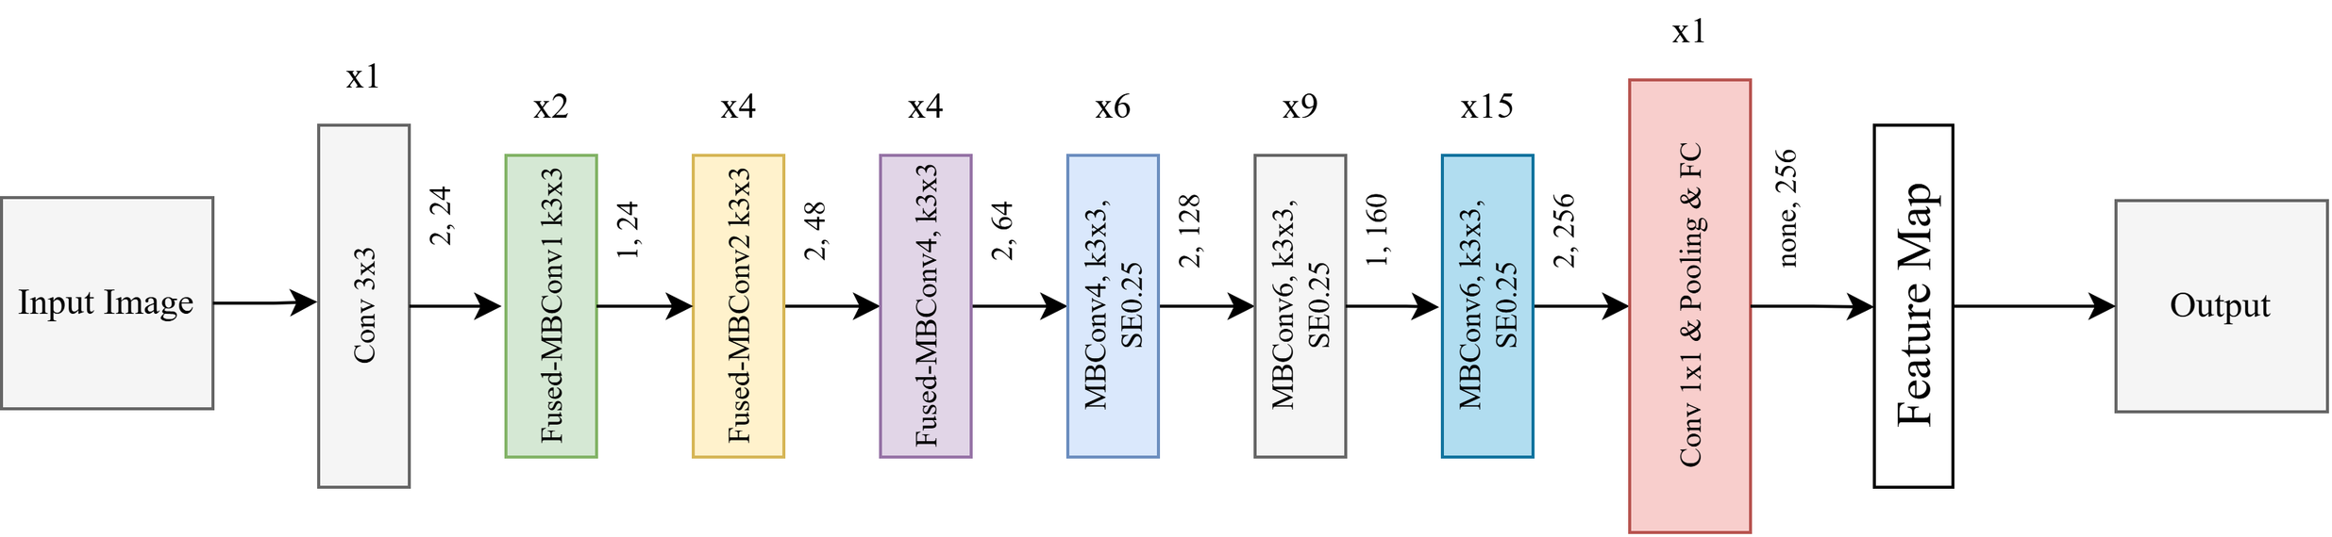
EfficientNetV2-S Architecture
Notes:
9

Slide 12
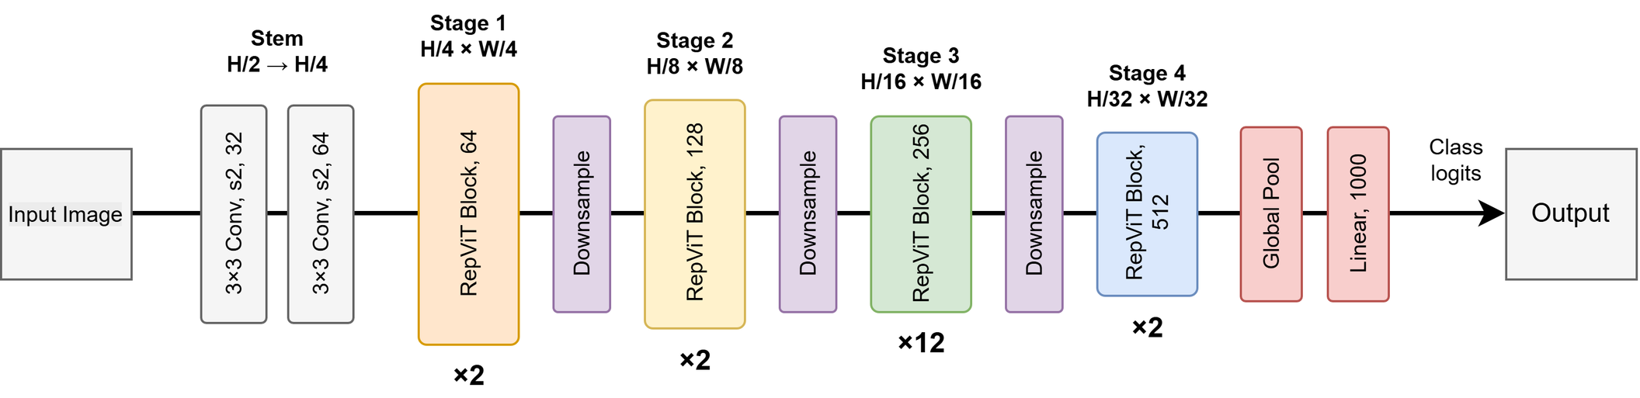
RepViT Architecture
Notes:
9

Slide 13
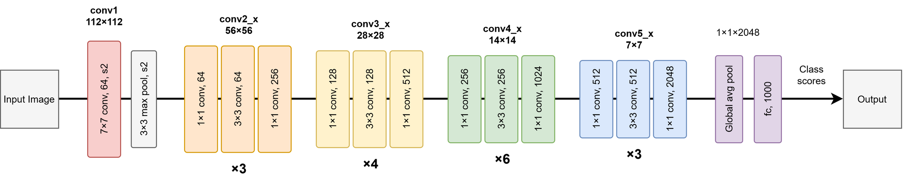
ResNet50 Architecture
Notes:
9

Slide 14
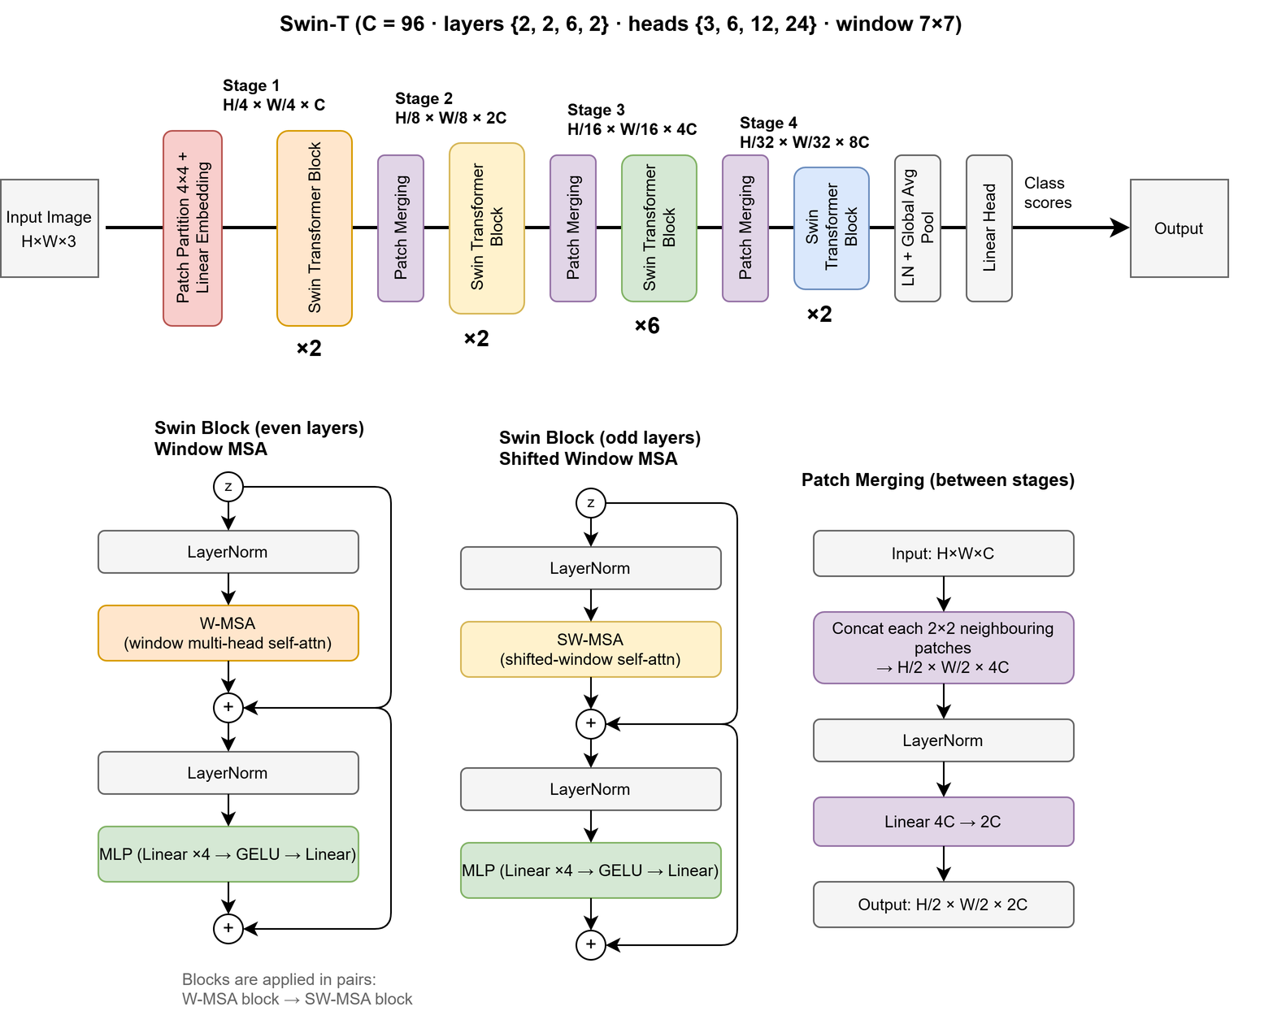
Swin-Tiny Architecture
Notes:
9

Slide 15
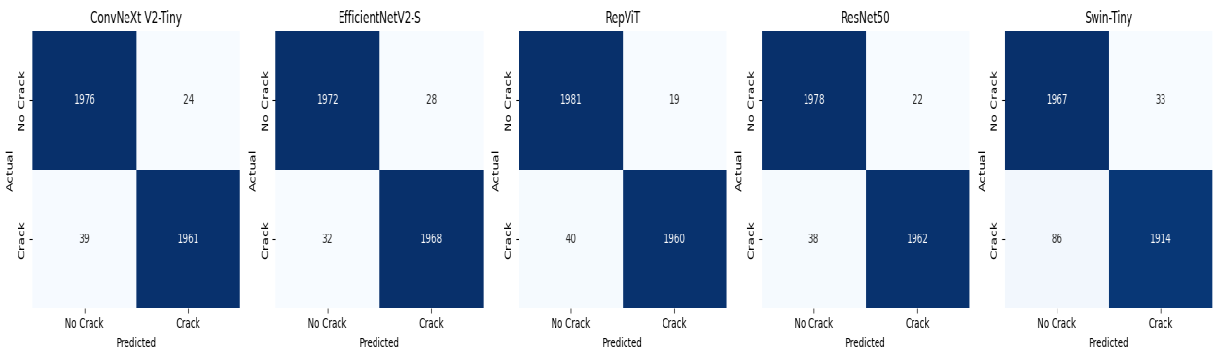
WORK COMPLETED: CONFUSION MATRICES
Fewest false positives
Fewest false negatives
Weakest on cracks
RepViT: 19 no-crack images flagged as crack.
EfficientNetV2-S: 32 cracks missed, the most important error for safety.
Swin-Tiny: 86 cracks missed and 33 false alarms.
Notes:
10

Slide 16
WORK COMPLETED: TEST-SET METRICS
Model | Accuracy % | Precision % | Recall % | Specificity % | F1 %
ConvNeXt V2-Tiny | 98.42 | 98.79 | 98.05 | 98.80 | 98.42
EfficientNetV2-S | 98.50 | 98.60 | 98.40 | 98.60 | 98.50
RepViT | 98.52 | 99.04 | 98.00 | 99.05 | 98.52
ResNet50 | 98.50 | 98.89 | 98.10 | 98.90 | 98.49
Swin-Tiny | 97.02 | 98.31 | 95.70 | 98.35 | 96.99
Best accuracy, precision, F1
Best ROC-AUC
RepViT: 98.52%, with precision 99.04%.
ResNet50: 99.79%, strong class separation.
Notes:
11

Slide 17
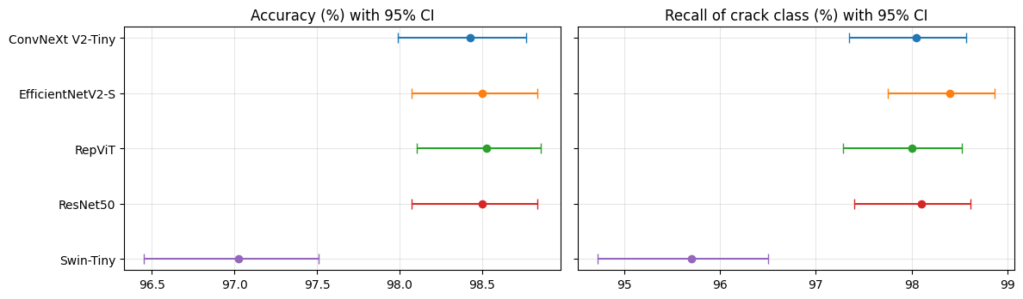
PERFORMANCE WITH 95% CONFIDENCE INTERVALS
Overlapping intervals
Swin-Tiny separated
The intervals of the four pretrained models overlap, so their differences are small.
Its interval sits clearly lower on both accuracy and crack recall.
Notes:
13

Slide 18
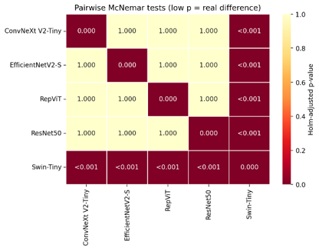
STATISTICAL SIGNIFICANCE: MCNEMAR TEST
Pretrained models are tied
Holm-adjusted p = 1.000 between every pair of ConvNeXt V2-Tiny, EfficientNetV2-S, RepViT and ResNet50.
Swin-Tiny differs
p < 0.001 against all four other models.
Swin-Tiny was trained from scratch, so this gap reflects both architecture and initialization.
Notes:
14

Slide 19
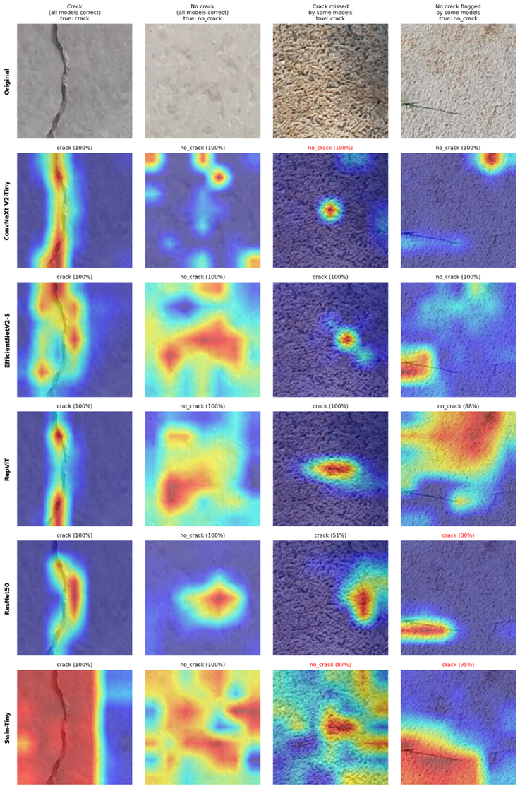
MODEL INTERPRETABILITY WITH
GRAD-CAM
Correct cases
Models highlight the crack line itself, while no-crack surfaces show scattered activation.
Error cases
The crack on rough texture was missed by ConvNeXt V2-Tiny and Swin-Tiny. ResNet50 and Swin-Tiny flagged a no-crack image containing a thin dark mark.
Caution
Grad-CAM is qualitative. It does not prove a model learned the physical features of a crack.
Notes:
15

Slide 20
LIMITATIONS AND FUTURE WORK
01
Dataset scope
02
Uncontrolled comparison
One 40,000-image dataset; lighting, weather, texture and camera angle vary in real structures.
Next: Add external validation, e.g. SDNET2018.
Swin-Tiny used no pretrained weights, so results mix architecture and initialization.
Next: Repeat with identical training settings.
03
Binary output only
04
Deployment
No crack location, length, width or severity.
Next: Extend to segmentation and severity classes.
Not yet tested in real-time inspection.
Next: Compress models for UAV and edge devices.
15
Notes:
16

Slide 21
CONCLUSION AND KEY TAKEAWAYS
01
Strong results overall
All five models reached 97.02% to 98.52% test accuracy on 4,000 images.
02
Pretrained models are statistically tied
RepViT led accuracy, precision and F1; ResNet50 led ROC-AUC (99.79%).
03
Choose models by more than accuracy
Consider false negatives, computing cost, training strategy and interpretability.
Next: crack localization and segmentation, cross-dataset validation, severity assessment and real-time deployment.
Notes:
17

Slide 22

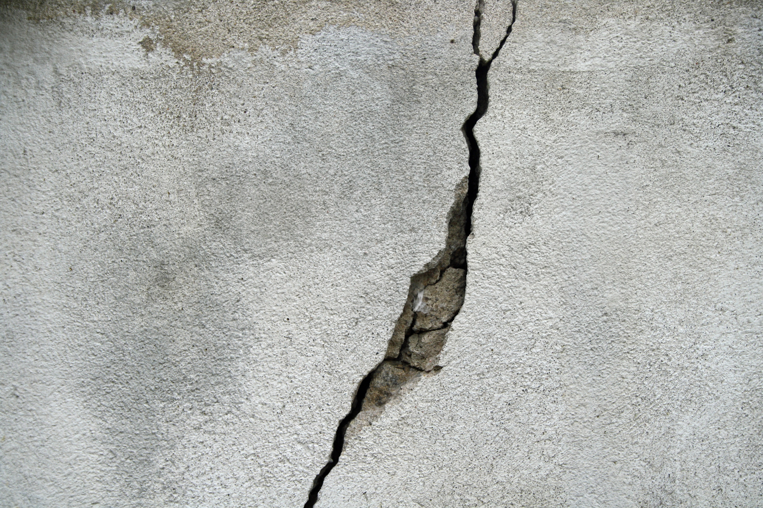
THANK YOU

